Slide 1
Heart Disease Prediction Using Hybrid Models MCR2
Progress Update

Slide 2
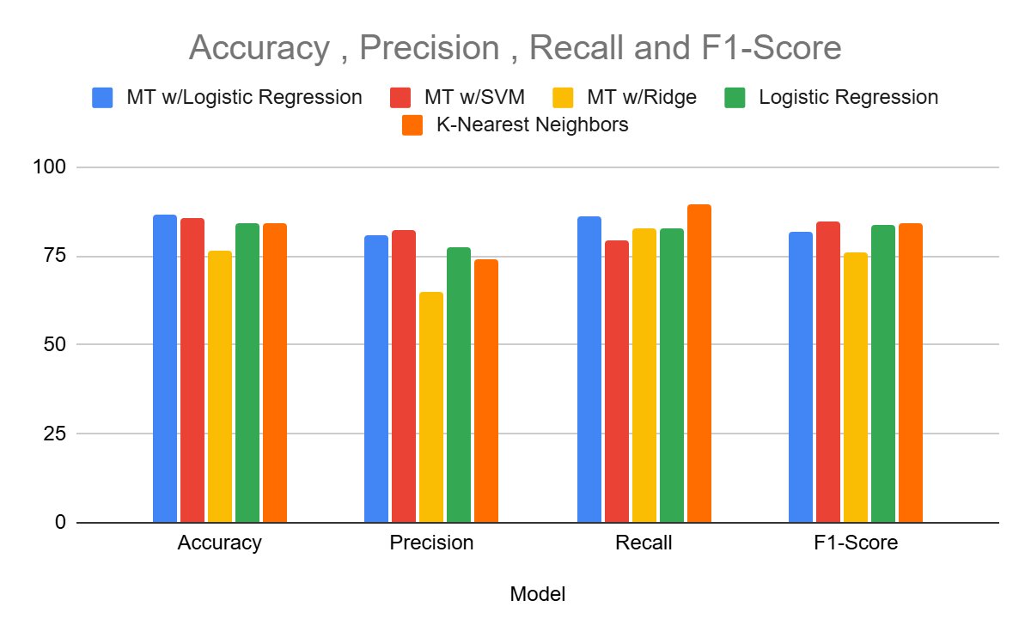
Model Switching and Results

Slide 3
Tabular Results
Model | Accuracy | Precision | Recall | F1-Score
MT w/Logistic Regression | 86.84 | 80.65 | 86.21 | 82
MT w/SVM | 85.52 | 82.14 | 79.31 | 84.5
MT w/Ridge | 76.31 | 64.86 | 82.78 | 76
Logistic Regression | 84.21 | 77.41 | 82.76 | 83.5
K-Nearest Neighbors | 84.21 | 74.29 | 89.66 | 84

Slide 4

Thank You For Your Time!
Thank You For Your Time!

Slide 5
h(x(i)) = log (m1x1 + ….. )

